Slide 1
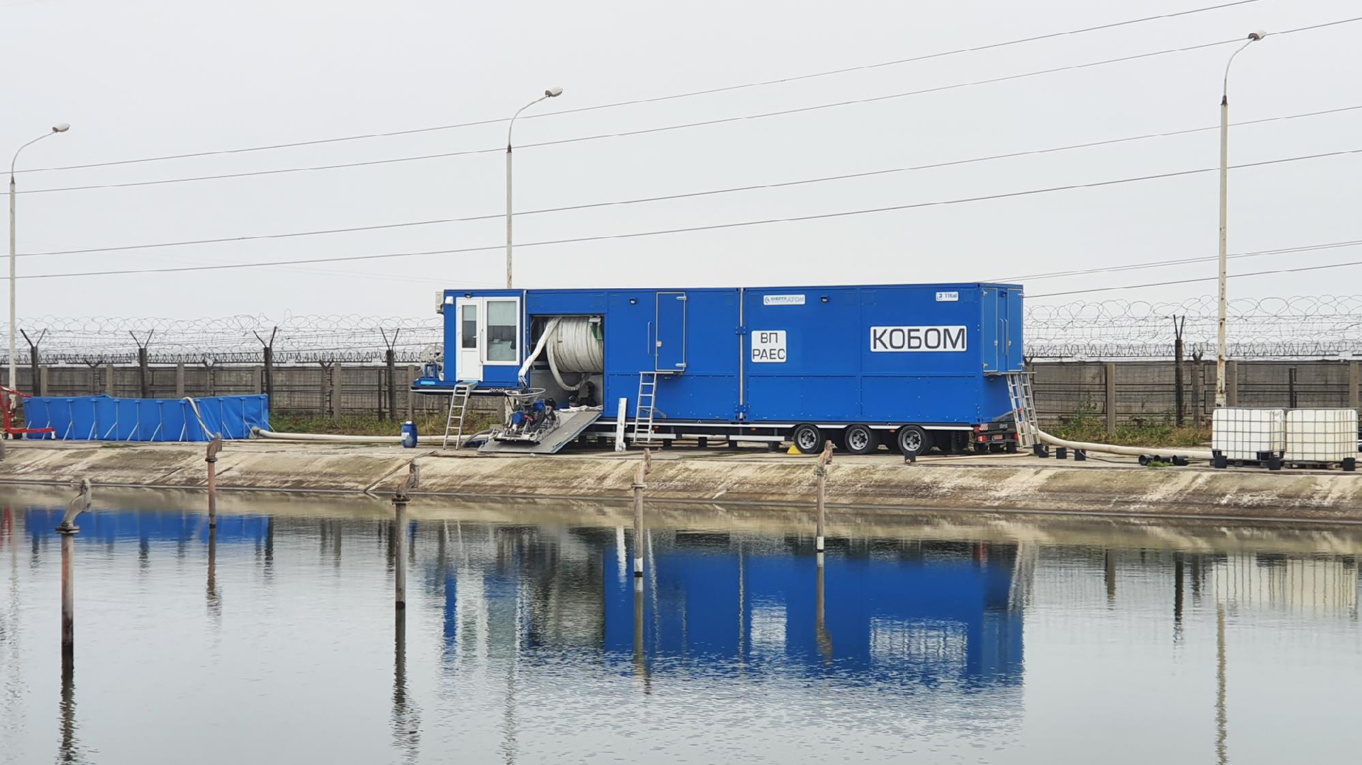

COMPLEX FOR CLEANING COOLING BASINS FROM BOTTOM SEDIMENTS
“KOBOM”
2025

Slide 2
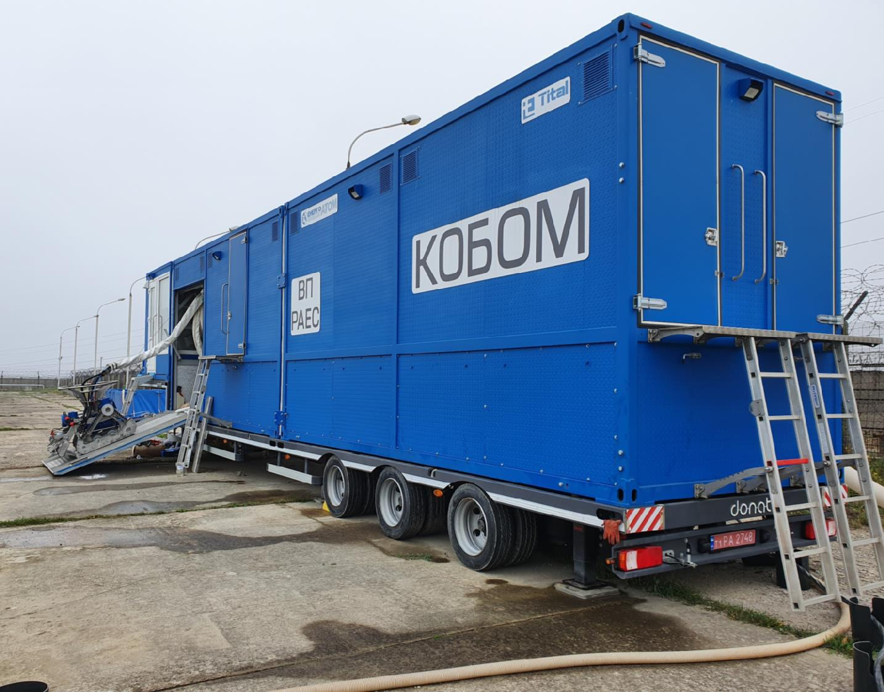
Appointment
KOBOM - unique, the only development in the world.
Carrying out works on cleaning and dewatering bottom sediments from the bottom and coastal slopes of treatment facilities and cooling basins of NPP power units during the operation of technical water supply systems.

Slide 3
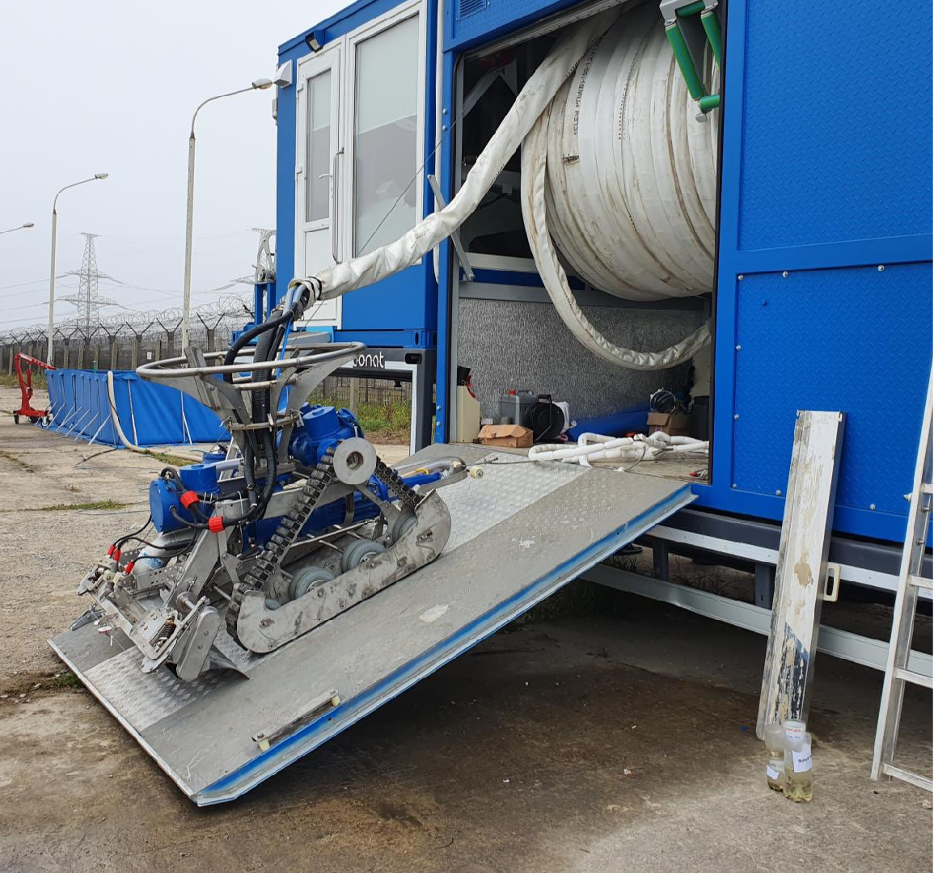
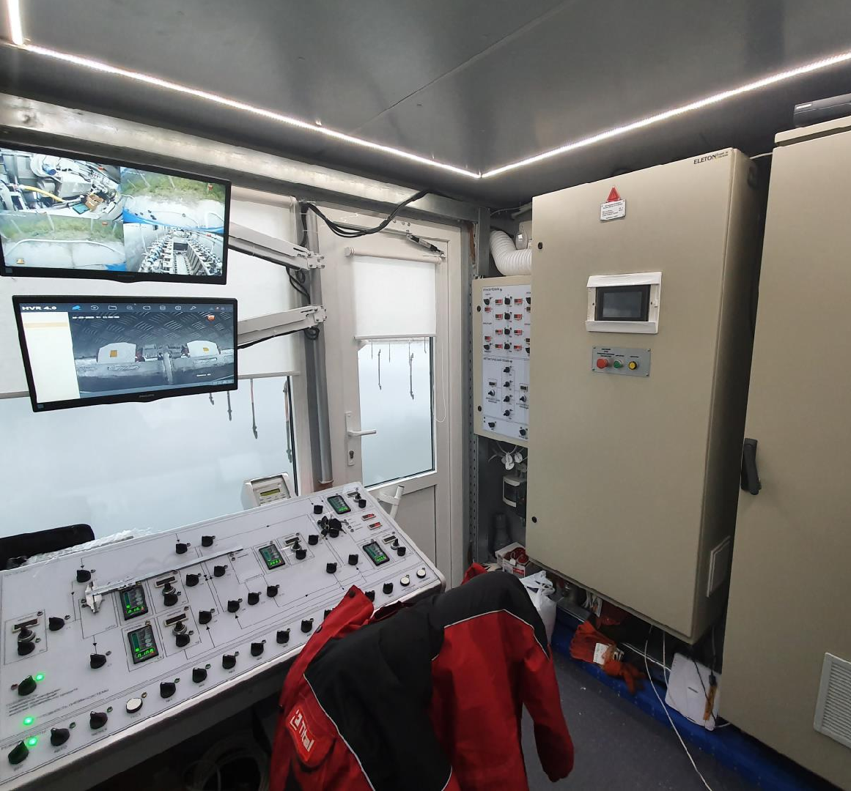
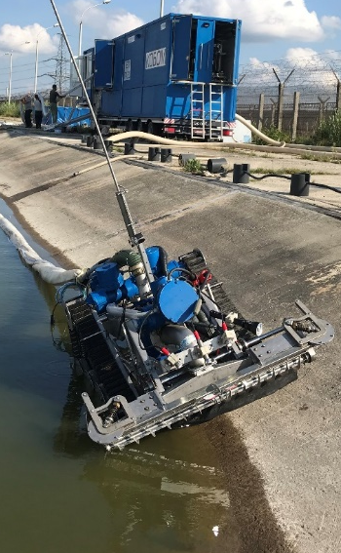
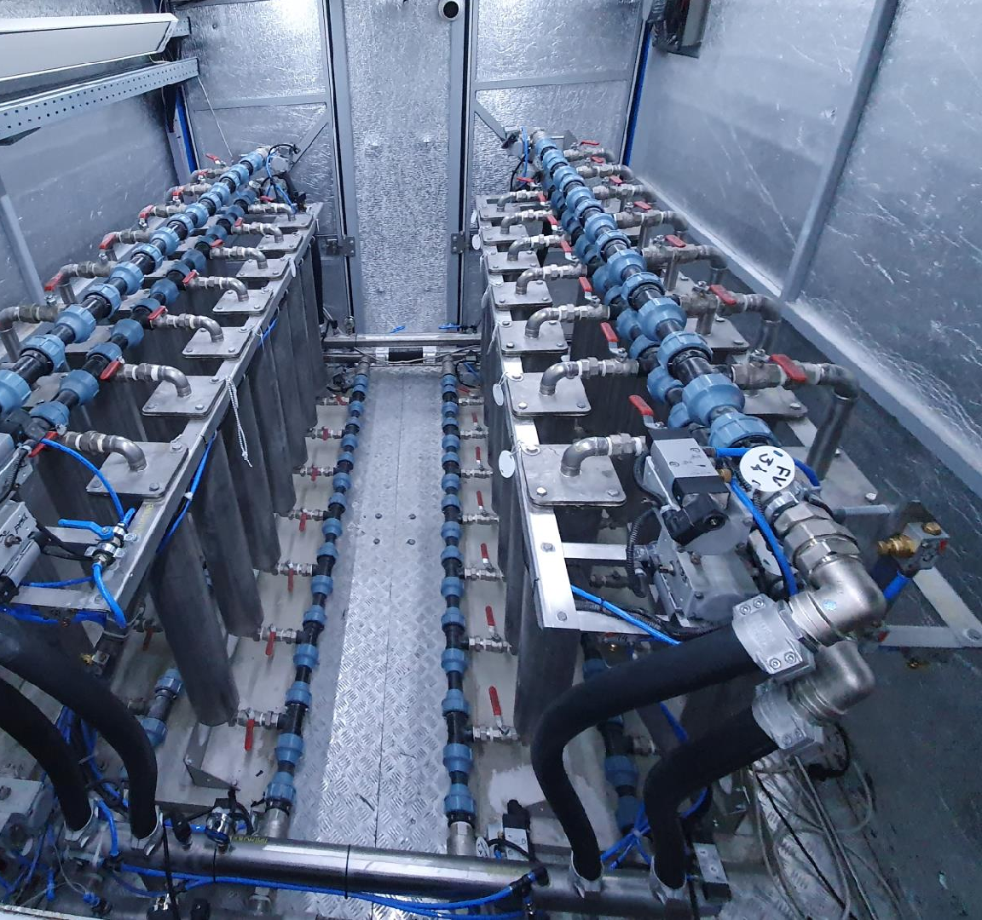
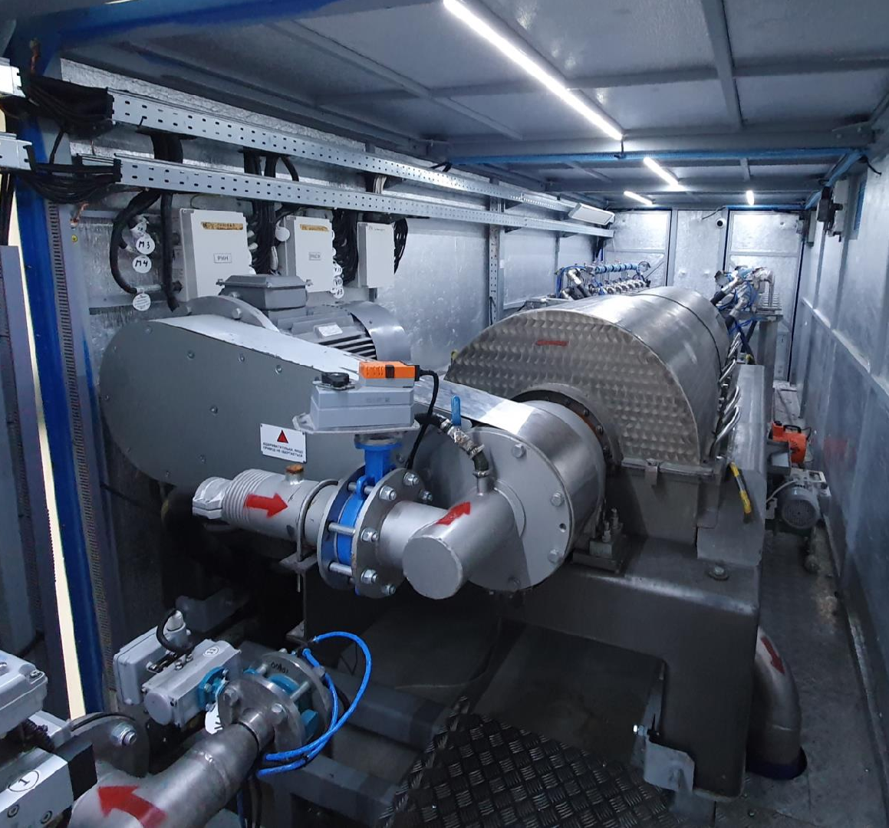
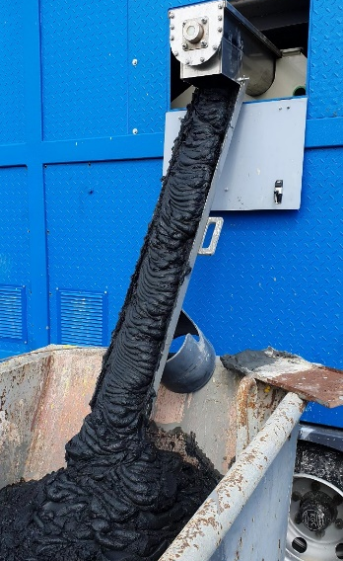
Description
KOBOM is a complex of special
equipment located on the vehicle.
Bottom sediment cleaning
done with
a small-sized self-propelled platform capable of moving along the bottom of the spray pool, pumping sludge into a dewatering unit located on the shore.
Dehydration and filtration is carried out using
a complex of cleaning equipment placed in containers.

